Slide 1

CRIS.PY
Ingredient Object Detection &
Recipe Recommendation Engine
Leang Chaing
Notes:
Hi my name Leang Chaing and today I'm going to be talking to you about something that haunts me on a daily basis...

Slide 2
What’s for dinner?
Notes:
...What's for dinner? Imagine you got a little crazy at the farmer's market with buying produce or are trying to eat more vegetables and are tired of salads. What do you do?

Slide 3
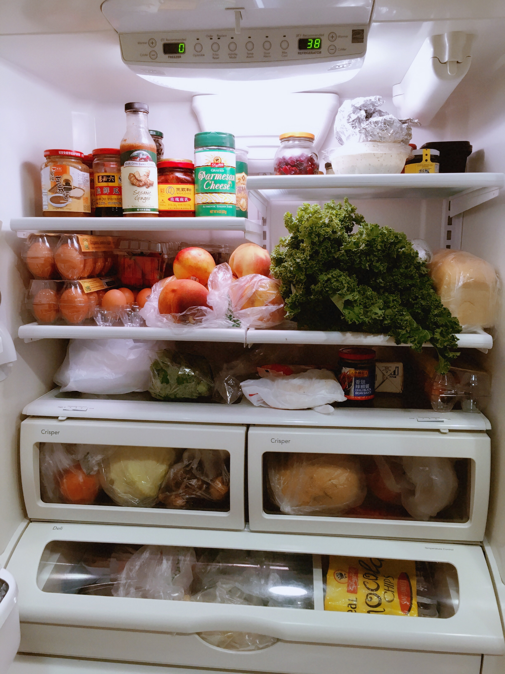
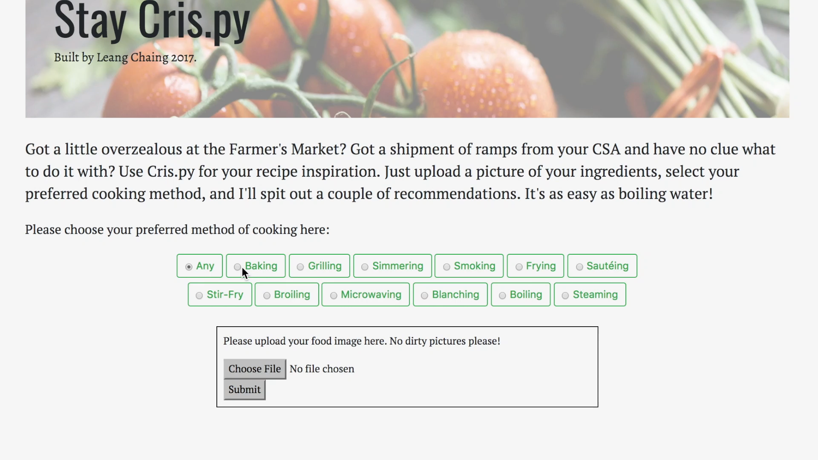

Cris.py: Recipe Recommendations for Your Fridge
Notes:
I created Cris.py to help. Cris.py can identify up to 40 different food items in a picture – just upload an image of your fridge or food basket and choose your preferred method of cooking. The program will recommend a variety of recipes based off what you have on hand.

Slide 4
Cris.py: Recipe Recommendations for Your Fridge
Focus on healthy and fresh ingredients found in the fridge
50% of all produce is thrown out in the US
$160 Billion Dollars wasted
Object detection algorithms automatically identify up to 40+ popular food ingredients from a single photo
Result: 6 recipe options based off available ingredients & preferred cooking method
Notes:
I focused of healthy and fresh ingredients typically found in fridges because they’re often the items people have most difficulty cooking. they’re also the most prone to waste. Over 50% of all produce in American is thrown out annually. This equates to 160 Billion dollars wasted.
Cris.py empowers home chefs to cook any day of the week and minimizes the waste they generate.

Slide 5
Data Sources
4,300+ images scraped from Google Images of 43 ingredient categories and stock fridge pictures
Images tagged and classified with VoTT
5,000+ unique recipes scraped from SeriousEats.com
Notes:
To build Cris.py, I scraped and tagged over 4k images from Google and over 5k recipes from SeriousEats, which personally, is my go-to resource,.

Slide 6
The Special Sauce
Selective Search: ROIs Calculated
Notes:
How does Cris.py work? When an image is uploaded, regions of interests (ROIs) are generated using selective search. These are areas in the picture that most likely have an object in them.

Slide 7
The Special Sauce
Selective Search: ROIs Calculated
NMS: ROIs Minimized
Notes:
Excessive ROIs are filtered out using non-maxima suppression for efficiency sake.

Slide 8
The Special Sauce
Selective Search: ROIs Calculated
NMS: ROIs Minimized
CNN: ROIs Classified
Notes:
Each remaining ROI is inputted into a convolutional neural net to classify the object.

Slide 9
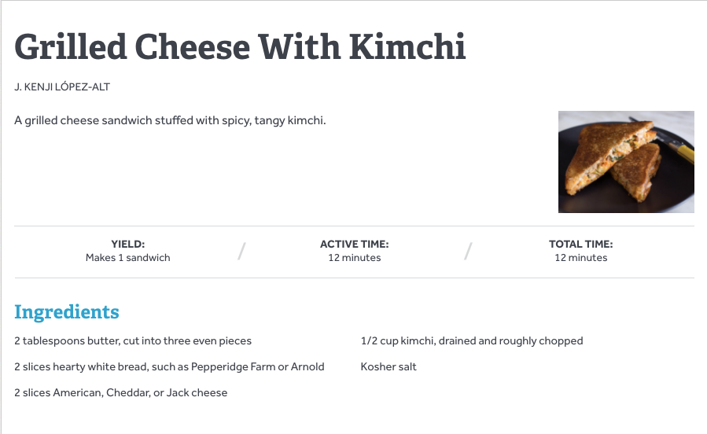
The Special Sauce
Selective Search: ROIs Calculated
Nouns & Adjectives Extracted using NLP. Bigrams & Trigrams generated.
NMS: ROIs Minimized
CNN: ROIs Classified
Notes:
On the recipe side, I extract the nouns and adjectives from the text and create bigrams and trigrams using genism phraser. After some cleaning, these are the ingredients for each recipe

Slide 10
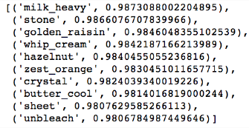
The Special Sauce
Selective Search: ROIs Calculated
Nouns & Adjectives Extracted using NLP. Bigrams & Trigrams generated.
Ingredients vectorized & plotted out per recipe
NMS: ROIs Minimized
CNN: ROIs Classified
Notes:
I then vectorize the ingredients

Slide 11
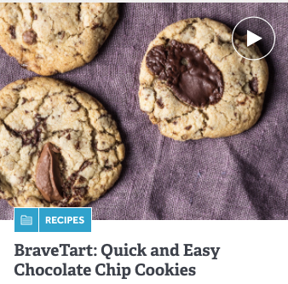
The Special Sauce
Selective Search: ROIs Calculated
Nouns & Adjectives Extracted using NLP. Bigrams & Trigrams generated.
Ingredients vectorized & plotted out per recipe
NMS: ROIs Minimized
Cosine similarity calculated to generate recs
CNN: ROIs Classified
Notes:
And calculate the cosine similarity between the ingredients for each recipe and the ingredients detected in the image to create the recommendation.

Slide 12
Cris.py 1.0 – Fast R-CNN
Notes:
To hone further into the CNN, I first tried using Fast R-CNN, a process designed for quick multiple object detection. I essentially took all the tagged food images and threw them into the model to train…

Slide 13
Cris.py 1.0 – Fast R-CNN
25% Jaccard Similarity
22% Mean Precision Score across all categories
Notes:
And got horrible results. It could only precisely detect 22% of the foods.

Slide 14
Cris.py 2.0: Transfer Learning using CNTK & ResNet 18
Create own food image classification model using transfer learning
Apply model to each ROI and aggregate classes within each photo
Notes:
The problem with Fast R-CNN is that while it’s a great generalized model, i needed someone more specialized to differentiate the nuances between kale and spinach. I decided to train my own food classification model using transfer learning. I took a model great at feature extraction, ResNet 18 and retrained it so that instead of detecting roses

Slide 15
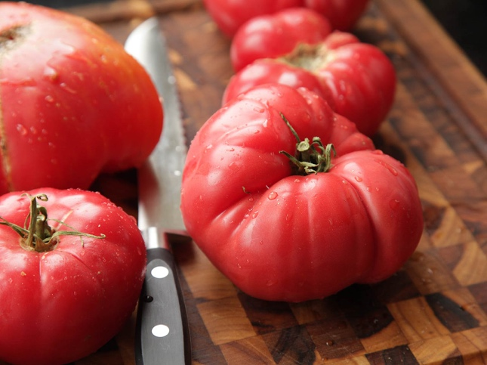
Cris.py 2.0: Transfer Learning using CNTK & ResNet 18
Create own food image classification model using transfer learning
Apply model to each ROI and aggregate classes within each photo
Notes:
It could detect tomatoes.
With my own classification model, I could apply it to each ROI to determine the individual ingredient within the image.

Slide 16
Cris.py 2.0 – Transfer Learning
93.4% Jaccard Similarity for image classification
51% Mean Precision Rate for object detection
Notes:
The result had a huge jump in performance. If you upload a picture of an apple to Cris.py, it can detect it accurate 93% of the time. When you give it a picture of something with multiple objects, it can detect about half of the food items precisely.

Slide 17

leang.chaing@gmail.com
linkedin.com/in/leang-chaing/
github.com/leangdamang
Notes:
If you’d like to learn more about Cris.py or would love to chat about food, please feel free to look at the code in my github or talk to me after presentations. Thanks and happy eating!

